Slide 1
Credentialing 101 (Overview)
Merrilee Severino, CPC, CMMP, NC Senior Consultant, Health Care

Slide 2
Credentialing – Definition
Credentialing refers to the process of verifying the proven skills, training, and education of healthcare providers. Internally or Externally (facility/plan)
Privileging is the process whereby a specific scope and content of patient care services. To determine a provider is capable of performing services applied for.

Slide 3
Credentialing – History
Credentialing can be traced back to 1000 BC. In ancient Persia, in order to obtain licensure a physician had to treat three heretics and they had to survive to qualify. They were then allowed to practice for the rest of their lives.

Slide 4
Health Care Practitioners
Types of providers that would need to be credentialed:
Payors (insurances) –”revenue generating provider”
MD medical doctor and DO doctor of osteopathy
Midlevels: PA physician assistant, ARNP advanced registered nurse practitioner, SA surgical assistant
Behavioral Health (LPC, PhD, and more), Podiatry (DPM)
Facilities will also “credential” RN, LPN etc

Slide 5
Processes
The process by which payors credential is mostly electronically and sometimes paper.
Facilities are transitioning more to electronic applications and some are still paper process

Slide 6
Credentialing – Services CLA Offers
Here at CLA we only do the paperwork required to enroll/credential a provider with a payor or obtain privileges at a facility. We are not a CVO (credentials verification organization). We do not verify the info, but we help transition from a paper/manual process to an electronic software platform (Modio), etc.

Slide 7
Credentialing – Current CLA Clients
Invite and encourage open communication with our clients. Credentialing and Privilege requests take teamwork for the process to work efficiently.

Slide 9
Continuity is Important

Slide 10
Timelines
Allow enough time. Most credentialing can be done within 90 days, but you want to allow yourself 150 days.
Remember the clock doesn’t start ticking until we have received all the information needed.
Timelines are determined by rate in which information supplied to us and carrier capability.

Slide 11
Practice Information Required
Utilize organized templates to collect needed provider data, website passwords, etc.
Remote access to platforms & websites:
Various Carriers
Client’s internal shared drive, that contains all the supporting documentation to expedite the delivery of information.

Slide 12
Provider Information Required
There are a lot of personal documents needed from a provider in order to credential them. These are just a few examples:
Drivers License, Passport,
Professional Headshot/passport size photo
Immunization Records
Login information for websites
Employment History, Peer References
Life Support Certifications
State Medical Licenses, DEA, CDS
TIMELINE from graduation onward

Slide 13
Credentialing – Initial Applications v Re-Credentialing
When a provider initially applies for privileges to facility there will be extensive information required and longer process for the facility to verify the information provided. This then goes before a board for approval.
Oftentimes facilities will re-credential providers every couple of years (depending on their by-laws) and will require a little less information.

Slide 14
CAQH an enrollment solution

Slide 15
CAQH – carriers reviewing your data
Insurance companies have bi-directional access and process enrollment for participation and EnrollHub for ERA/EFT sign up

Slide 16
CAQH – verifying Provider Data

Slide 17
DEA Drug Schedule
Drugs, substances, and certain chemicals used to make drugs are classified into five (5) distinct categories or schedules depending upon the drug’s acceptable medical use and the drug’s abuse or dependency potential.

Slide 18
States Determine What Mid Level’s can write for

Slide 19
DEA Drug Enforcement Agency nuances
Military ONLY
Government employees (county owned)
Can hold more than one and it needs to be tied to a practice location in that state

Slide 20
https://www.deadiversion.usdoj.gov/online_forms_apps.html

Slide 21
Identity and Access (I&A)
Create one account with the Identity & Access Management System to manage access to:
NPPES
PECOS (Medicare)
EHR incentive programs
Manage staff & authorize others to access information
This account is setup under the users *own personal information*, including your SS#, address and phone number.

Slide 22
https://nppes.cms.hhs.gov/IAWeb/login.do

Slide 23
This is ties to YOUR information

Slide 24
NPPES
The Administrative Simplification provisions of the Health Insurance Portability and Accountability Act of 1996 (HIPAA) mandated the adoption of standard unique identifiers for health care providers and health plans.
The purpose of these provisions is to improve the efficiency and effectiveness of the electronic transmission of health information. The Centers for Medicare & Medicaid Services (CMS) has developed the National Plan and Provider Enumeration System (NPPES) to assign these unique identifiers.
Type 1 for individual providers and Type 2 for Organizational providers. They associate your taxonomy number with your NPI.

Slide 25
https://nppes.cms.hhs.gov/#/

Slide 26
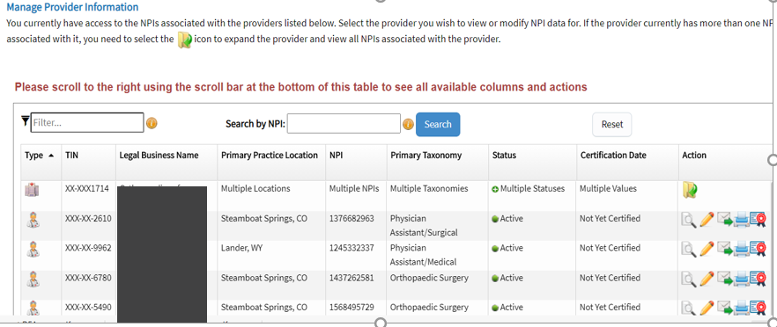
https://npps.cms.hhs.gov/IAWeb/login.do

Slide 27
PECOS Provider Enrollment, Chain, and Ownership System
PECOS supports the Medicare Provider and Supplier enrollment process by allowing registered users to securely and electronically submit and manage Medicare enrollment information.

Slide 28
https://pecos.cms.hhs.gov/pecos/login.do#headingLv1

Slide 29
https://pecos.cms.hhs.gov/pecos/login.do#headingLv1

Slide 31
Insurance Coverage
Malpractice COI is Certificate of Insurance (Example slide 28)
There are two main types claims made and per occurrence
“Bare”
Nose and Tail Coverage
Tail coverage (also known as an extended reporting period) is offered by the carrier with which coverage is expiring. This coverage increases the length of time a claim can be reported for treatment dates within the policy period. The cost is generally a percentage of the expiring policy premium determined by the desired length of the tail coverage.
Alternatively, nose coverage (also known as prior acts coverage) can be purchased when a practitioner changes carriers. Nose coverage will provide protection under the new policy if claims are reported in the future for treatment dates going back to the previous policy inception date.

Slide 32
Additional Insurance Considerations
Loss Run is a report that the provider can obtain from the carrier with a list of payouts or lack of payouts (Example slide 29)
General Liability Policy – for the building

Slide 33
COI example:

Slide 34
Loss Run Example:

Slide 35
NPD National Practitioner Data Bank
Providers can do a self-query which will show information reported on malpractice payments, adverse licensure or privileging actions or if judgements or convictions were found.
Entities that report include malpractice payers hospitals and other health care entities, professional societies, health plans, peer review organizations, private accreditation organizations, and certain federal and state agencies.
Self query $4
https://www.npdb.hrsa.gov/

Slide 36
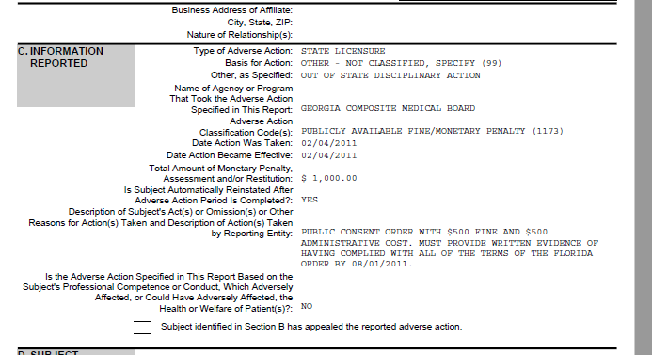
Self Query Example:

Slide 37
Self Query

Slide 38
Self Query

Slide 39
Board Certification
American Board of Medical Specialties has 24 member boards representing 40 specialties and 87 subspecialties
AOABOS and ABPS each have associated with national medical organizations functioning as an umbrella for its various specialty academies.

Slide 40
Board Organizations
Some of these organizations include:
American Board of Medical Specialties (ABMS)
American Medical Association
American Osteopathic Association Bureau of Osteopathic Specialists (AOABOS)
American Osteopathic Association
American Board of Physician Specialties (ABPS)
American Association of Physician Specialists

Slide 41
BC vs BE Board Certified / Board Eligible
When a person graduates medical school they become an MD (medical doctor) or a DO (doctor of osteopathy). They then have to get a medical license from the state in which they are wanting to practice. They can then continue their education post medical school in the form of a residency (post graduate training) which can be 3-5 years and this is specialty specific. Some specialties allow you to take the written exam during residency. They can then complete their board certification by taking an oral board one year after completion of the residency. You cannot take a board exam more than three times. If you fail the board three times you are then board ineligible. Important to note that a general practitioner does not have a board so they are not BC or BE.

Slide 42
Case Logs – aka Activity Logs
Lack of uniformity – self reported
Do not want to see PHI on them
Looking for experience with number of types procedures performed

Slide 43
Case Log - Example

Slide 44
Privileging Requests– Hospital & Facilities
Hospital applications go before a board for approval
-Board may only meet every four to six weeks
If a privilege on form is not requested and needed may delay your provider from doing procedures there.
*ASC’s are normally pretty fast

Slide 45
Hospital & Facilities Privileging Checklist - Example

Slide 46
Differences in Privileges
OB epidural for pain vs epidural for anesthesia
Ortho – unique due to types of cases spine etc

Slide 47
CME Continuing Medical Education
Medical licensing board requirement
FL requires 40 CME q 2 yrs CO requires 0 (political ie AIDS/domestic violence)
Specialty Board certification requirements
Facility requirements

Slide 48
Disclosure Questions
Any health or mental problems which could affect his/her ability to perform the requested privileges.
Disciplinary challenges to licensure or certification?
Voluntary or involuntary termination of membership
Professional liability actions
Yes answers require an explanatory statement
Tricky – “EVER” vs In the last 2 years pending/settled (if sealed and you disclose you give up your protection) reword the same question

Slide 49
Disclosure Questions

Slide 50
Letter of Explanation
For any “yes” answers
Best to have an attorney summary for settled actions
Be sure you have reviewed answers with the practitioner

Slide 51
FCVS – Federation Credentials Verification Service

Slide 52
How we at CLA keep it all organized
Templates- we have customized templates depending on our clients needs.
Timelines-
Communication- weekly meetings are immediately set up with our client as well as internal meetings

Slide 53
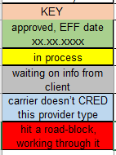
Credentialing Updates 10.06.2020 (Client) Credentialing Rep at CLA: Name AR & Credentialing Specialist Email Address

Slide 54
Facility Applications Updates 10.06.2020 (Client) Credentialing Rep at CLA: Name AR & Credentialing Specialist Email Address

Slide 56
Individual and Practice Information

Slide 57
Dashboards and Alerts

Slide 58
Reminders

Slide 59
Thank you! For questions, please contact:
Merrilee Severino, CPC, CMMP, NC Senior Consultant, Health Care
E: Merrliee.Severino@CLAconnect.com
P: 727-408-0225

